Slide 1
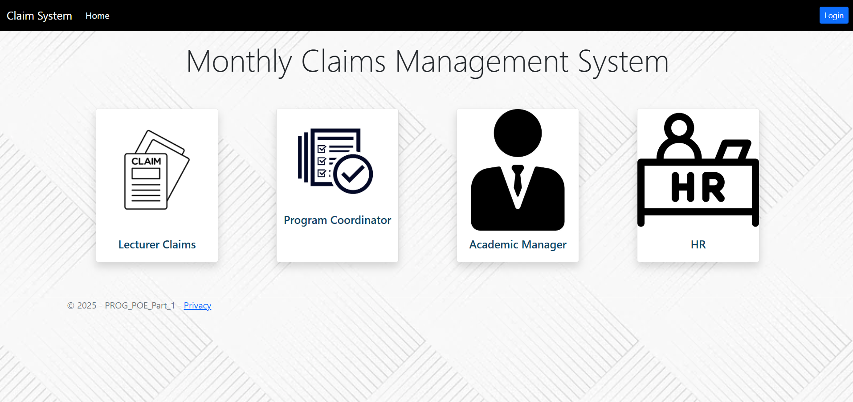
PROG POE Final
Name: Joel Napier
Student Number: ST10457625

Slide 2
Overview
The claim system now auto calculates the final payments based on the hours worked to the rate that is set by the HR as well as validates that the information is correct.
The system automates the claim submission, verification, approval, and HR processing. Improving the overall efficiency, accuracy and tracking.
The system works in a workflow 3 levels: Lecturer → Coordinator → Manager
The system now incorporates role-based access using session-based authentication.
Entity Framework is used to manage the database operations, ensuring that claims, users and reviews are saved accordingly.
HR has the ability to generate reports and has the option to convert to a pdf downloads through using LINQ

Slide 3
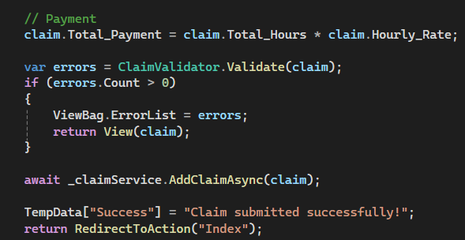
Automated Payment Calculation
This code ensures that the final payment is auto calculated based on the hours worked set by the lecturer, and the hourly rate set by HR
The built in validation ensures accurate values are shown, it has correct formatting and has complete data before submission

Slide 4
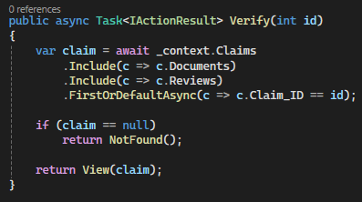
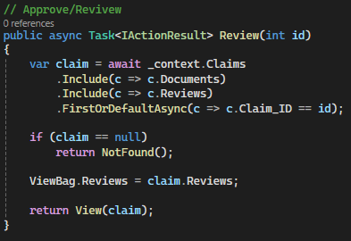
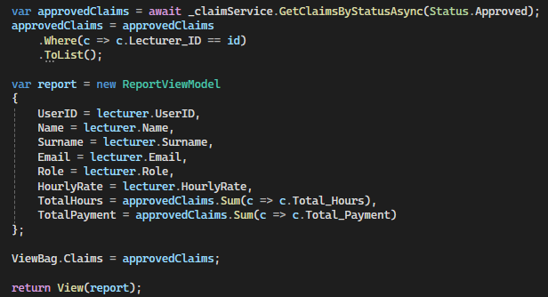
End-to-End Automation
Coordinator
This system automates the entire claim system life cycle improving the efficiency, accuracy and tracking of the claims process.
This starts as :
- A claim is first submitted by a lecturer.
- This is then verified and reviewed by the programme coordinator
- It then goes to the manager for final approval and reviewal.
- HR then finalizes the process.
Manager
HR

Slide 5
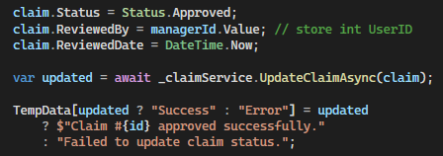
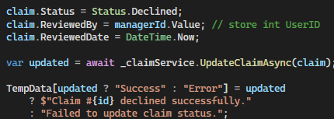
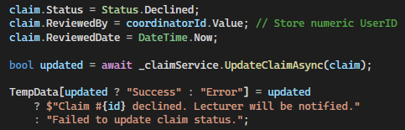
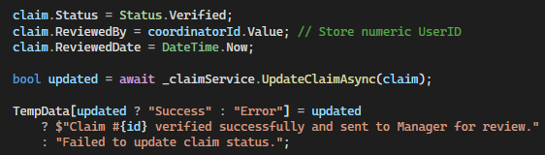
Workflow Structure
This ensures that after each step the claims moves through, the status is updated accordingly. This ensures accountability and transparency, preventing any unauthorized approvals while also creating a clear audit trail.
Lecturer submits a claims
Coordinator Verifies/Declines
Manager Verifies/Declines

Slide 6
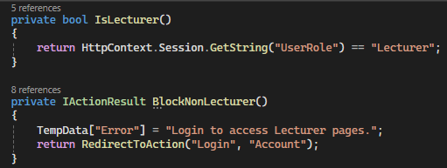
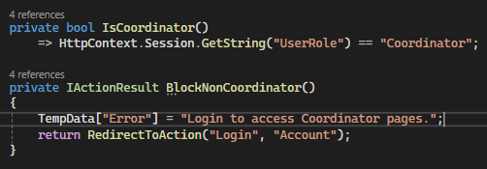
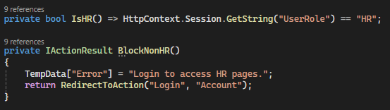
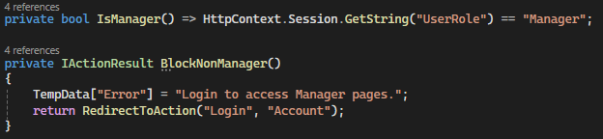
Role-Based Access
This is done using session based authentication. Ensuring that users only features based on their assigned role. Such as:
Lecturer → Submit Claims
Coordinator → Verify Claims
Manager → Approve Claims
HR → Add Users, Process and Generate reports

Slide 7
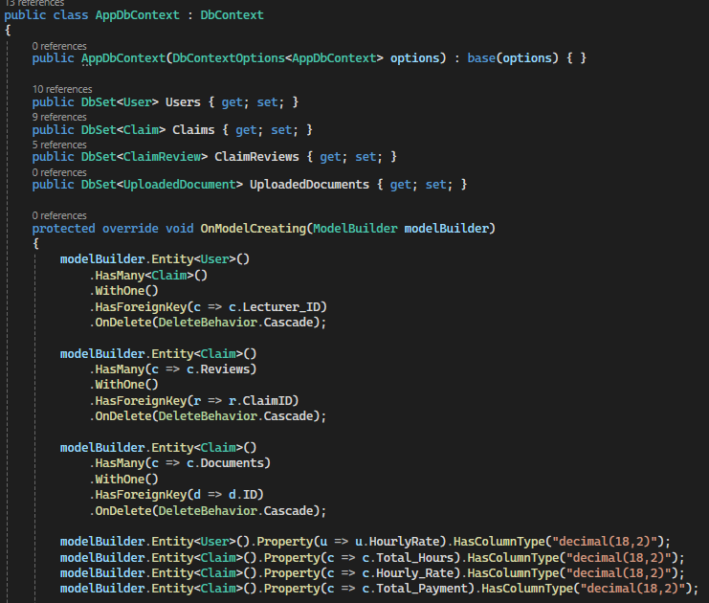
Database and Entity Framework
Entity framework is used for all data interactions. This includes saving of claims, accounts and reviews. This then provides better data integrity, much cleaner code and a faster development

Slide 8
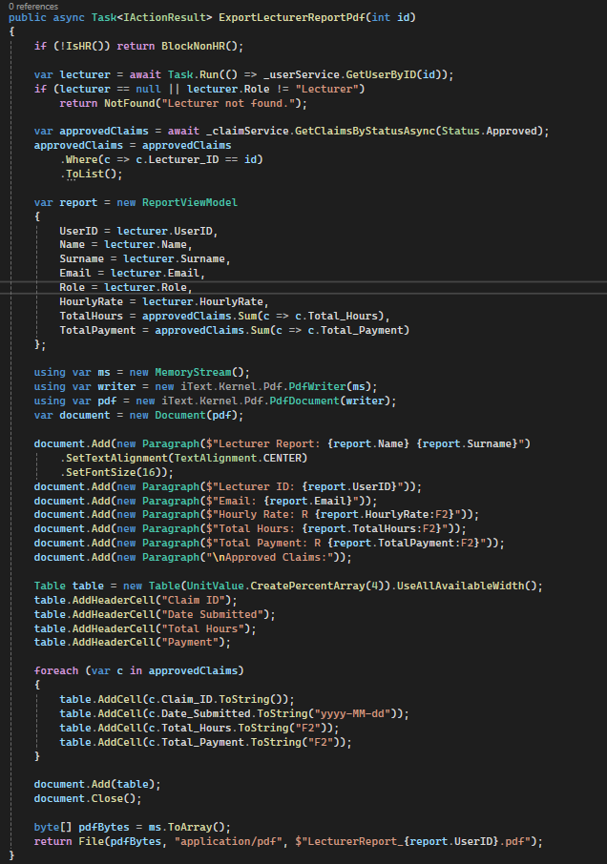
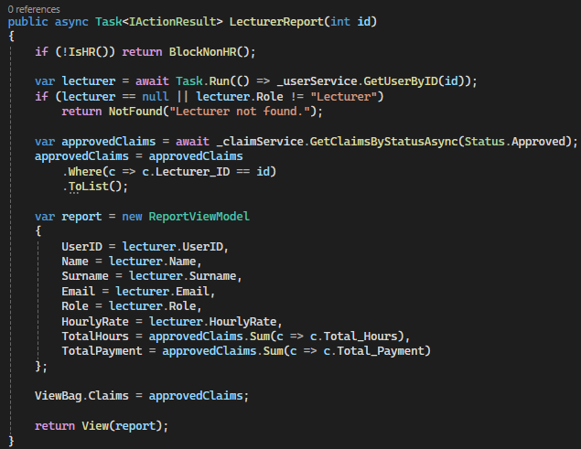
HR Reports
HR can generate automated summary reports using LINQ. In these reports it includes the lecturers details, their total hours worked, total payment and the list of all approved claims. There is then an option to convert this report into a downloadable pdf.

Slide 9
Conclusion
All of the newly added features now improve the overall productivity through:
Automating the claim management system
Enforcing approval workflows
Supporting role based access
Enhancing HR ability to track, process and report claims

